Slide 1

Kaggle Columbus Competition Presentation by Oliver Foster

Slide 2

Problem & Methodology
Problem:
Columbus wants an algorithm built to target shoppers likely to spend money at their online store based on interaction with their website
Methodology:
Inspect the data with visualizations
Clean the data
Hot-encode categorical columns
Feature engineering
Gridsearch for best combination of model and hyper-parameters

Slide 3
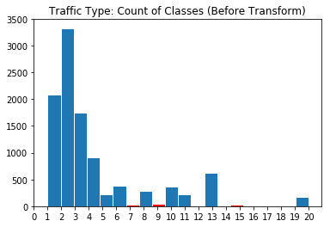
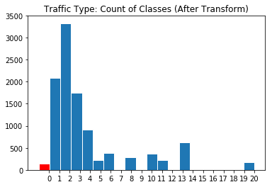
Data Cleaning Problem: Underrepresented Categories
Problem:
Certain features (OperatingSystems, TrafficType, and Browser) had categories with very little representation
Solution:
Assign minority categories to one “Other” category

Slide 4
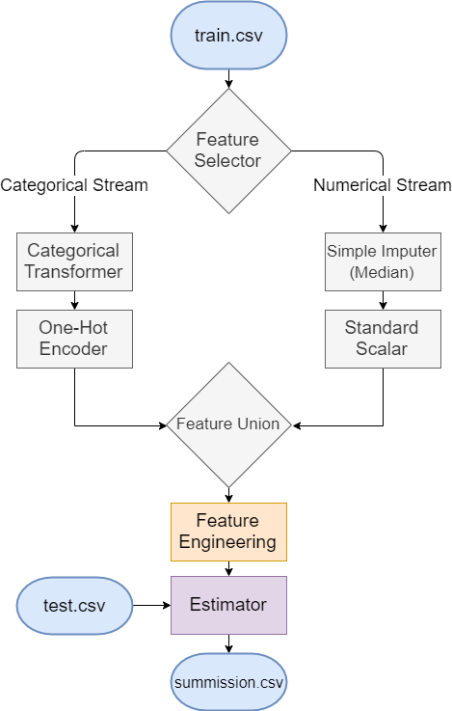
Pipeline & Gridsearch
Feature Engineering Grid:
SelectFromModel
Thresh = [0, '0.5*mean', '0.75*mean', ‘mean’, '1.25*mean‘]
Estimator Grid:
LogReg, Bagging, Boosting, Random Forrest, SVC
All with their own hyper-parameter grids
5-fold Cross-Validation
~350 unique grid combinations (~1750 fits)

Slide 5
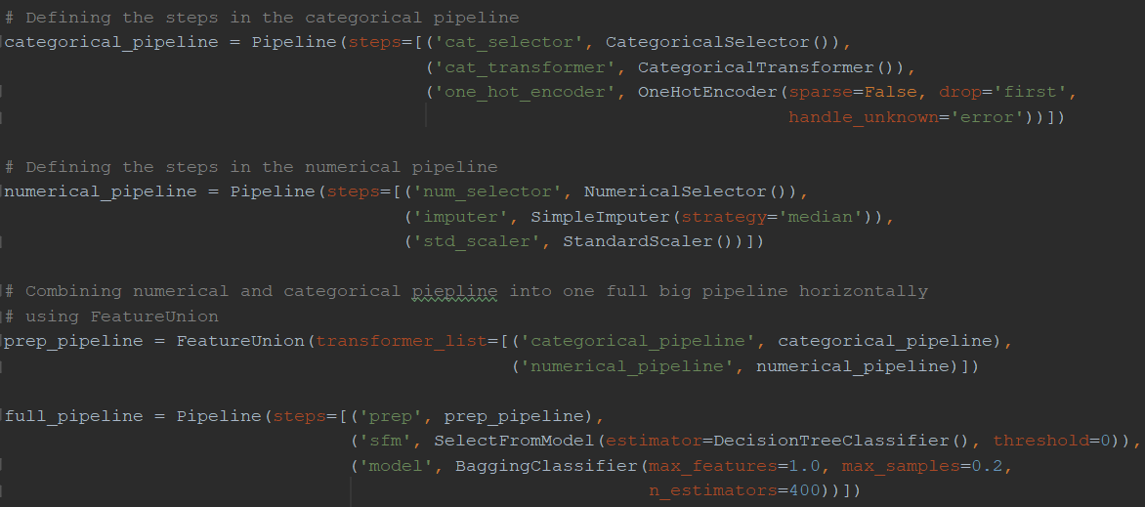
Pipeline in Scikit-Learn

Slide 6
Summary of Results
Data Prep Methodology | Feature Engineering | Estimator | Scoring Metric | Score
Hot Encoding & Median Imputer | None | Bagging Classifier (Decision Tree Estimator) | Accuracy | 0.91459
Hot Encoding & Median Imputer | SelectFromModel with 0.5*mean threshold | Random Forrest Classifier | Accuracy | 0.90054
Hot Encoding & Median Imputer | (Performed by DNN) | Dense Neural Network Classifier | Accuracy | 0.89621
Hot Encoding & Median Imputer | SelectFromModel with 0.75*mean threshold | Gradient Boosting Classifier | F2 Score | Prec: 0.724299 Rec: 0.612648 F2: 0.632137
Hot Encoding & Median Imputer | None | Gradient Boosting Classifier | ROC AUC | 0.931 (excellent)

Slide 7
Reccomendation
For an OOTB solution – take the Gradient Boosting tuning for F2 score
OR
For an advanced client wanting to tune their own thresholds – take the Gradient Boosting tuning for ROC AUC score

Slide 8
THANKS!
Any questions?
You can find me at:
oliverfoster27@gmail.com
https://www.linkedin.com/in/oliver-foster-19684a89/
https://github.com/oliverfoster27/Kaggle-ColombusRetailClassification

